Slide 1
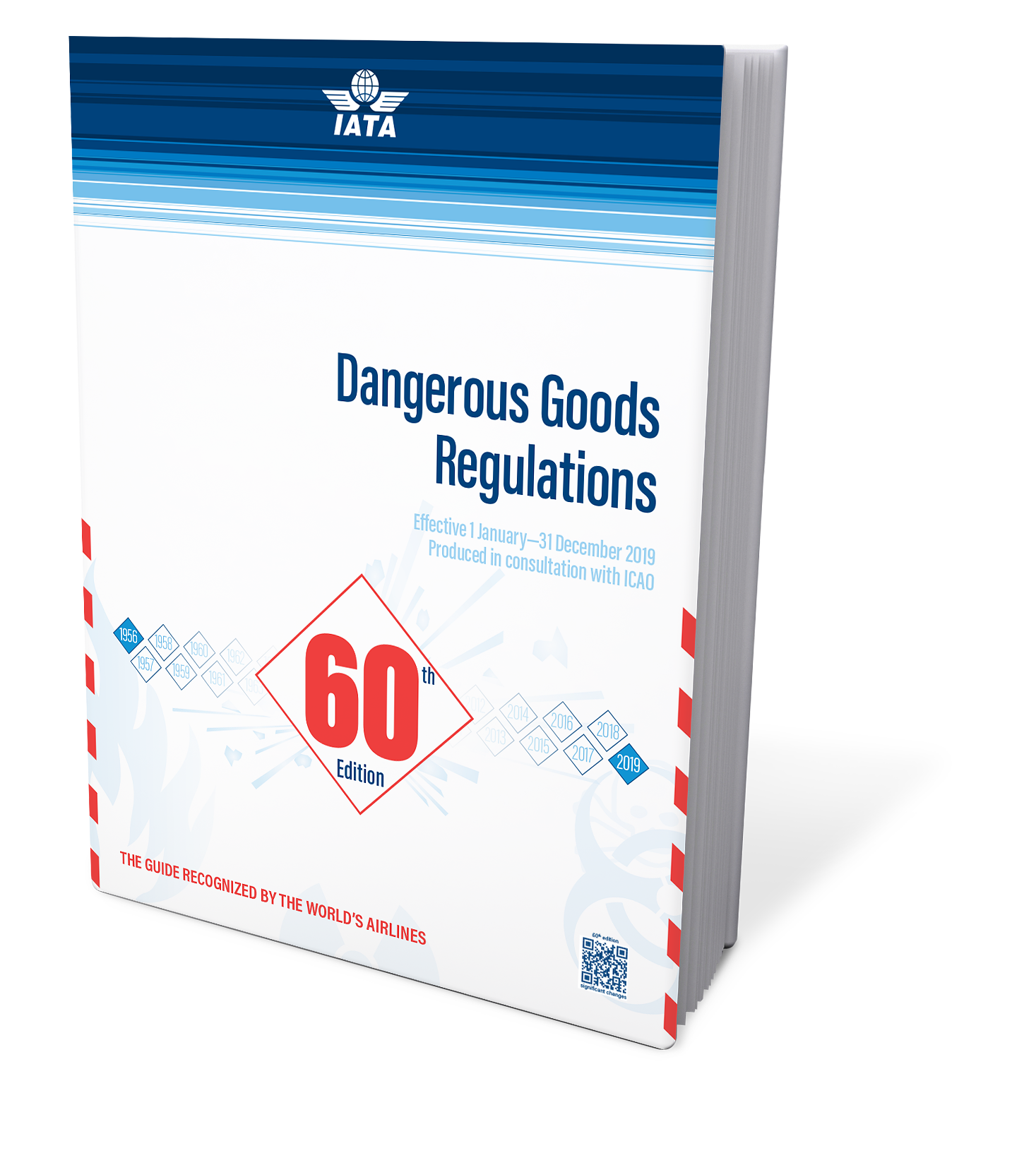
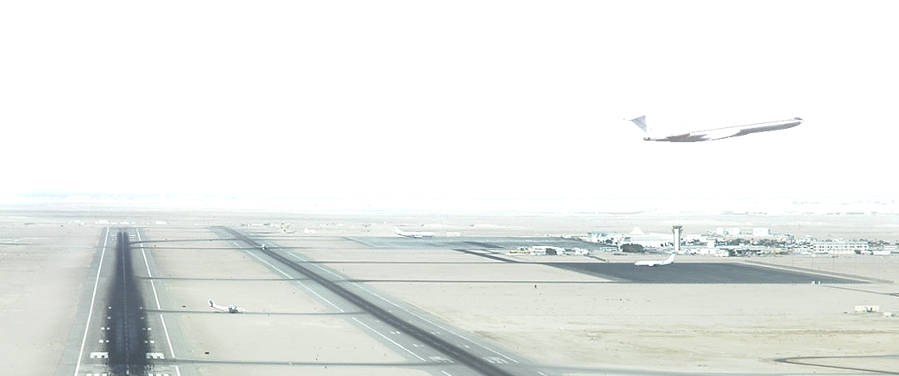
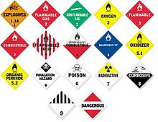
Indian Aviation Academy
National Institute of Aviation Management & Research Society
(Joint Venture - AAI, BCAS & DGCA, Govt. of India)
Indian Aviation Academy is now a DGCA approved
DGR Training Centre
Category 1,3 & 6 is for Six days
Category 2,4,5,7 & 8 is for two days
Category 9, 10, 11 & 12 is for one day; and
Awareness Programmes is also for one day
Training will be imparted by highly skilled and experienced IATA & DGCA approved Trainers.
As inaugural offer the IAA is offering a discount of 20% on the base rate of the training programme.
All aspiring candidates may apply for the training at the following
E-mail : iaadgrconsultant@aai.aero
Contact Numbers
+91-9871013977 +91-9717499663
011-26134358 Extn 211

